Slide 1
HUMAN TRAFFICKING IN ROMANIA
Authors: Boros Ștefan, Gherman Andrei, Drăgușin Cristian
Year: 2022

Slide 2
INTRODUCTION
DATASET = all the human trafficking victims that have been rescued in Romania in 2019 (N = 697).
We have attempted to find information about the population based on our sample:
-gender distribution
-average age
-relationships between age and region of the country
-relationships between age and method of exploitation
-regression models that predict the number of victims in a county relative to its population

Slide 3
LITERATURE REVIEW
Overwhelming lack of Romanian literature on the topic, other than yearly government reports
A European Commission report published in 2021: Romania has the highest rate of human trafficked victims per million inhabitants in the EU, at 74 per million
2019 = highest number of victims = pandemic start => more victims in general or easier to rescue?

Slide 4
LITERATURE REVIEW
FINDINGS OF ANNUAL GOVERNMENT REPORT IN 2019:
- The higher the age of the victims, the higher the likelihood of victims being trafficked externally.
- The likelihood of being trafficked internally is higher in the case of female victims.
- The lower the age, the higher the likelihood of sexual exploitation.
- The lower the age of the victims, the more likely they are to be recruited by strangers.
- The average period of time a victim is trafficked is 1 year, with a minimum of a few days and a maximum of 12 and a half years.

Slide 5
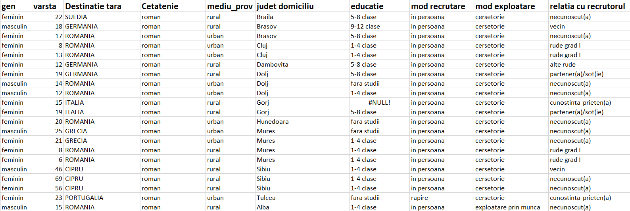
DATA USED
N = 697

Slide 6
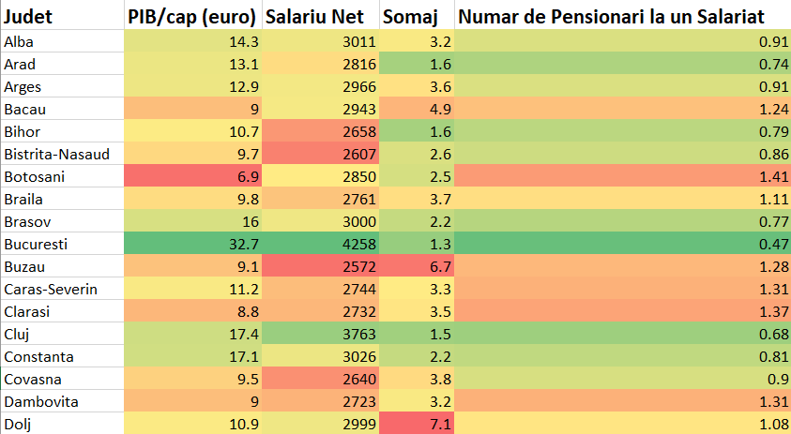
DATA USED
Economic indicators split by county

Slide 7
METHODOLOGY & FINDINGS
STRATIFIED RANDOM SAMPLING
Method of exploitation => 5 strata: begging, sexual exploitation, work exploitation, theft or a failed attempt
We find the average age of victims in the population
X bar = 20.97
Cl = 95% => [20.38; 21.56]
Cl = 98% => [20.33; 21.61]

Slide 8
METHODOLOGY & FINDINGS
HYPOTHESIS TESTING (t-test)
One-tailed test: the average age of a victim in the population is less than 20
Conclusion: FALSE at Cl=95% (3.088613 > 1.647 => t > tα; for α = 0.05)
Two-tailed test: 80% of the victims in the population are women
In our sample: ~83% are women
Conclusion: FALSE at Cl=95% (2.37795382 > 1.96 => t > t(α/2), for α = 0.05)

Slide 9
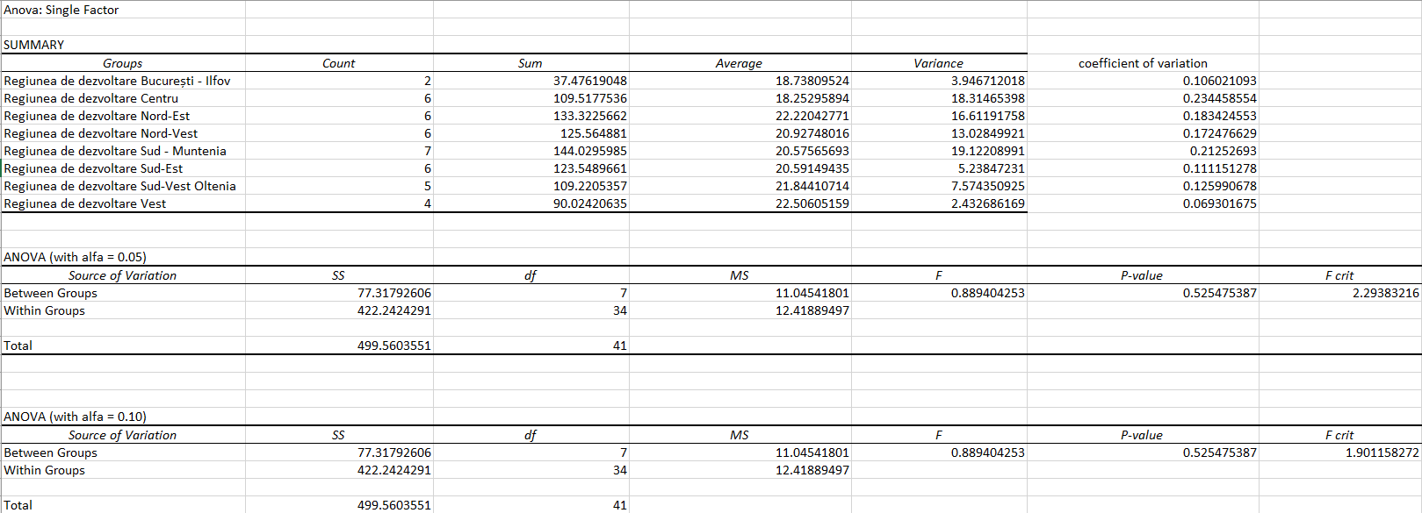
METHODOLOGY & FINDINGS
ANOVA – variation of age between regions

Slide 10
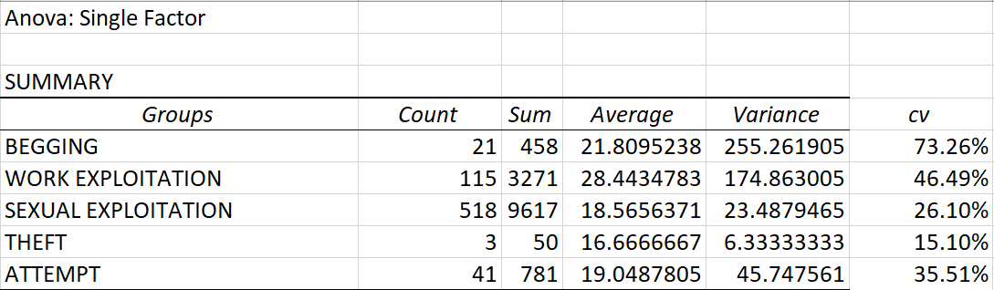
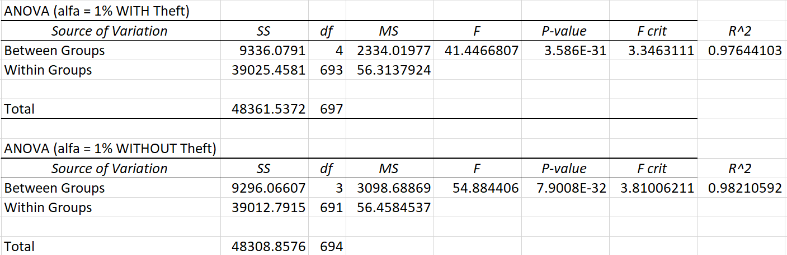
METHODOLOGY & FINDINGS
ANOVA – variation of age between methods of exploitation

Slide 11
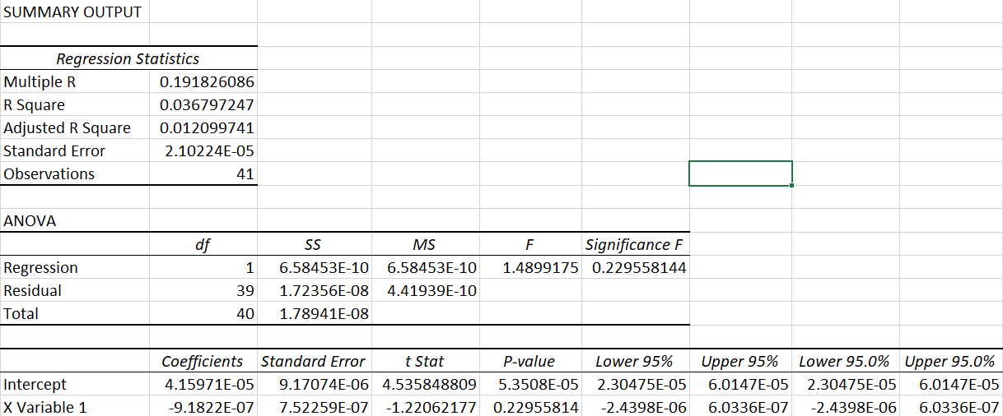
METHODOLOGY & FINDINGS
Simple linear regression: GDP/capital to predict number of victims?

Slide 12
METHODOLOGY & FINDINGS

Slide 13
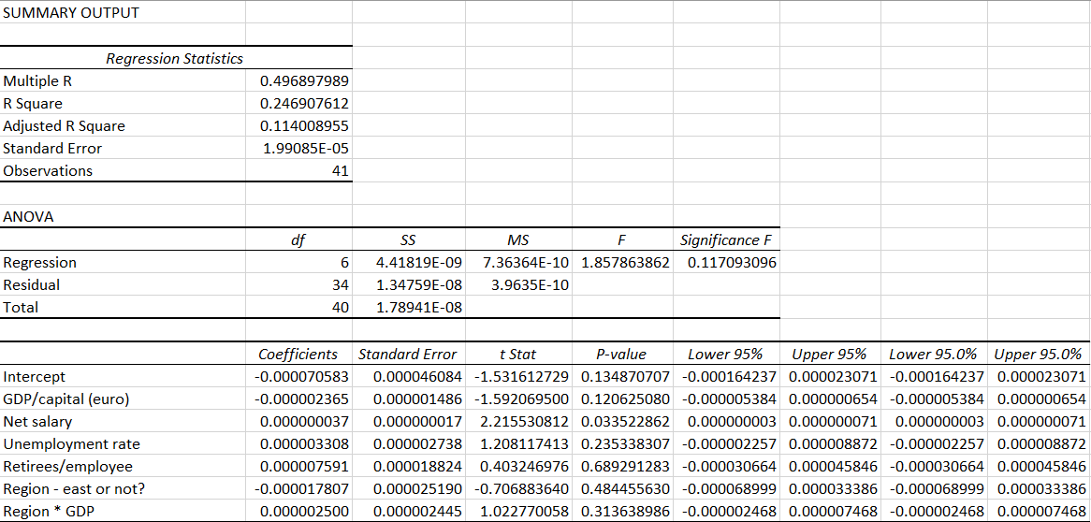
METHODOLOGY & FINDINGS – multiple linear regression

Slide 14
LIMITATIONS & POINTS OF IMPROVEMENT
BIASED SAMPLE! (Conclusions about all the victims in the population based only on the victims that have been saved??)
Data is only from 2019 => pandemic start
Improvement: panel data??

Slide 15
BIBLIOGRAPHY (data & literature review)
https://www.state.gov/reports/2021-trafficking-in-persons-report/romania/
https://balkaninsight.com/2021/06/03/romania-scraps-statute-of-limitations-for-human-trafficking/
https://anitp.mai.gov.ro/ro/docs/studii/Raport%20anual%20privind%20fenomenul%20traficului%20de%20persoane%20in%202019.pdf
https://panorama.ro/interactiv-economia-judetelor-romaniei/
https://www.eesc.europa.eu/sites/default/files/resources/docs/qe-01-15-435-ro-n.pdf
https://economie.hotnews.ro/stiri-finante_banci-24269496-trei-indicatori-care-arata-unde-mai-buna-viata-salariatior-din-romania-topul-judetelor-vulnerabile.htm

